Slide 1




REMOTE CONTROLLED HOME AUTOMATION SYSTEM
By Embeddworks
reallygreatsite.com

Slide 2

INTRODUCTION
Remote-controlled home automation systems represent a modern approach to managing household appliances and systems through digital interfaces. These systems enable users to monitor, control, and automate various home functions—such as lighting, heating, cooling, security, and entertainment—from a distance using smartphones, tablets, or voice assistants.
Key features include:
IR receiver – To detect the IR signals.
IR remote – To give commands to microcontroller.
Motor Driver – To apply PWM so that we can change the speed of fan.
Together, these components create a smart system that can be controlled by a remote, smartphones etc.
01

Slide 3
PROBLEM STATEMENT
In today’s fast-paced world, managing household appliances manually can be inefficient, time-consuming, and inconvenient—especially for working individuals, elderly residents, or those with mobility challenges. Traditional home systems lack the flexibility and intelligence to adapt to users’ needs remotely, leading to energy wastage, security vulnerabilities, and reduced comfort.
There is a need for a smart, remote-controlled home automation system that allows users to monitor and control household devices from anywhere using smartphones or other digital interfaces. Such a system should be reliable, secure, user-friendly, and capable of integrating various appliances to enhance convenience, energy efficiency, and safety.
02

Slide 4
Allow users to control appliances very conveniently and comfortably via remote.
It is very energy efficient it can monitor or schedule appliances.
OBJECTIVES OF THE PROJECT
It can be very useful for physically disabled persons. As they can’t move frequently, they can control it form a distance.
This system can be very cost effective by saving the wastage of electricity results in cutting of electricity bills.
03

Slide 5

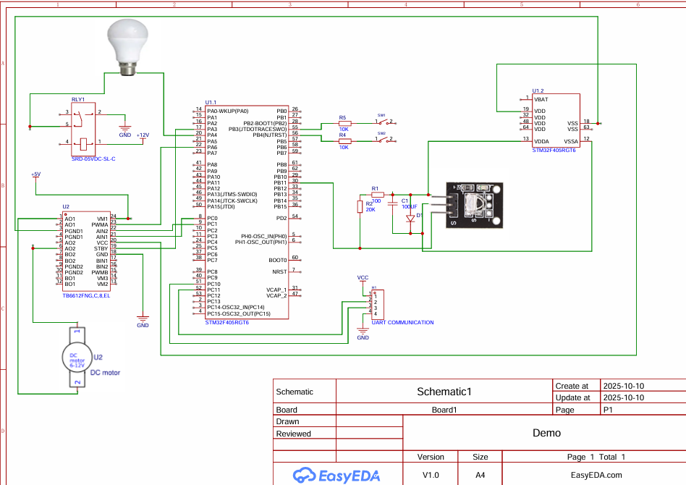
CIRCUIT DIAGRAM
05

Slide 6
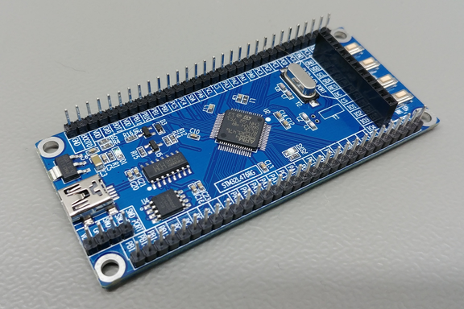
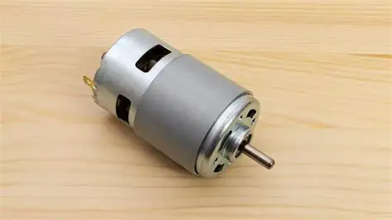
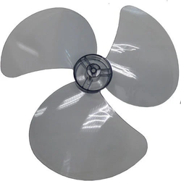
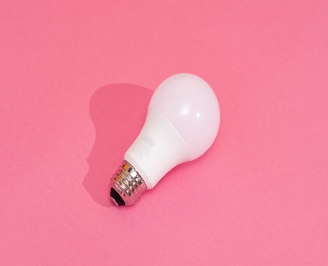
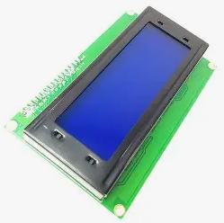
HARDWARE
COMPONENTS USED
Motor: Actuator which is used as fan in this project.
STM32 MICROCONTROLLER: Connect different electronic components for signal transfer.
FAN: To show the output of the fan.
Bulb: To show glowing light.
A 16x2 LCD display: This is here to display what is the current speed of fan etc.
06

Slide 7
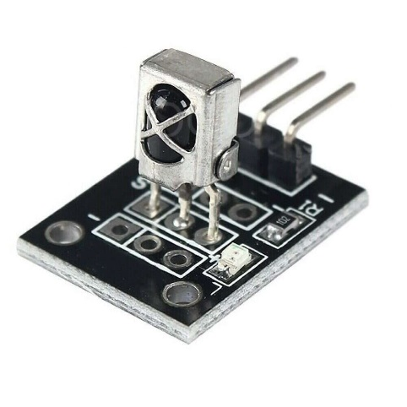
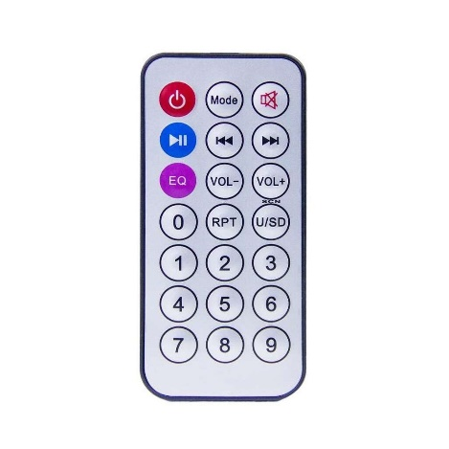
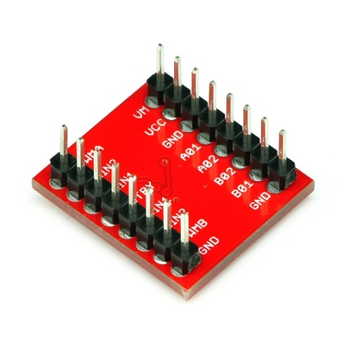
SENSORS USED
IR RECIEVER :
Receives the IR waves coming from the remote or any other devices and send it to microcontroller.
IR REMOTE:
Remote having IR waves transmitter to transmit IR waves.
MOTOR DRIVER:
Used for PWM channel to control the intensity or frequency of appliances.
07

Slide 8
An Infrared (IR) receiver module is an electronic component used to detect and decode infrared signals transmitted by an IR remote control. It plays a key role in remote-controlled systems, including home automation, TVs, and other consumer electronics.
Key Points:
1. Receives IR signals typically in the 38 kHz frequency range.
2. Demodulates the signal to extract the encoded data.
3. Compact and easy to integrate with microcontrollers like Arduino, Raspberry Pi, etc.
IR RECEIVER FOR WAVES DETECTION
08

Slide 9
A motor driver controller is an essential electronic device used to manage and regulate the operation of electric motors in various applications, such as robotics, automation systems, and vehicles. It acts as an interface between a microcontroller or processor and the motor, translating low-power control signals into high-power signals capable of driving the motor. Motor driver controllers typically support functions like speed control, direction control, braking, and protection against overcurrent or overheating. Depending on the motor type—DC, stepper, or brushless—different driver architectures are used, such as H-bridge circuits for DC motors or specialized ICs for stepper motors.
MOTOR DRIVER
09

Slide 10
RESULTS & OBSERVATIONS
IR Receiver : Continuously receiving the IR waves coming from remote and making a connection between user and microcontroller to control the appliances from a far away distance.
IR transmitter : Continuously transmitting the IR waves.
Motor driver : Indulges here in speed control of fan(actuator).
LCD Display: A 16x2 LCD display is here to display what is the current speed of fan etc.
Bulb : Glowing when given command.
12

Slide 11
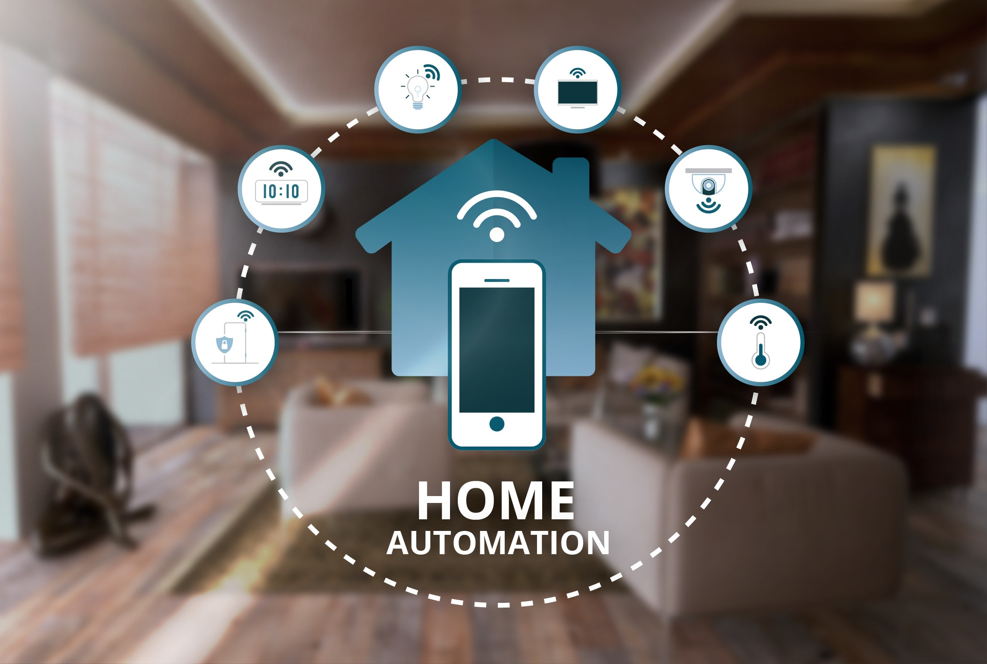
APPLICATIONS
Curtains and Blinds: Automated window treatments can be adjusted based on time of day or user preference, enhancing privacy and energy conservation.
Appliance Management: Devices like washing machines, ovens, and refrigerators can be operated or scheduled remotely, streamlining daily chores.
Lighting Control: Users can remotely switch lights on/off or adjust brightness and color using smartphones or voice commands, improving energy savings and ambiance.
Security Systems: Remote access to surveillance cameras, motion detectors, and smart locks enables real-time monitoring and control of home security.
13

Slide 12
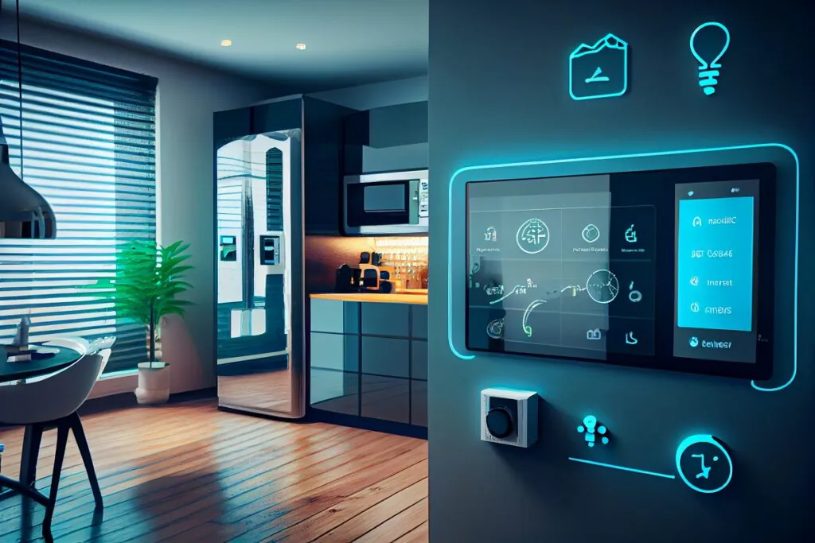
FUTURE SCOPE
Smart Cities Integration: Home automation will extend beyond individual homes to connect with smart city infrastructure—like traffic systems, public utilities, and emergency services.
Integration with AI and Machine Learning: Home automation systems will become more intelligent, learning user habits and preferences to automate tasks proactively—like adjusting lighting or temperature based on time, weather, or mood.
Security and Surveillance Evolution: AI-powered surveillance will offer predictive threat detection, automated alerts, and integration with law enforcement systems for faster response.
14

Slide 13
CONCLUSION
In conclusion, the development and implementation of a remote-controlled home automated system marks a significant step toward smarter, safer, and more energy-efficient living environments. This project demonstrates how integrating technologies like IoT, wireless communication, and microcontrollers can provide users with seamless control over household appliances and systems from anywhere. The system not only enhances convenience and comfort but also contributes to better resource management and security.
Key Points:
Enhances security.
Very useful for disabled persons.
Can be controlled from anywhere with IOT integration which makes it more approachable.
15

